Slide 1


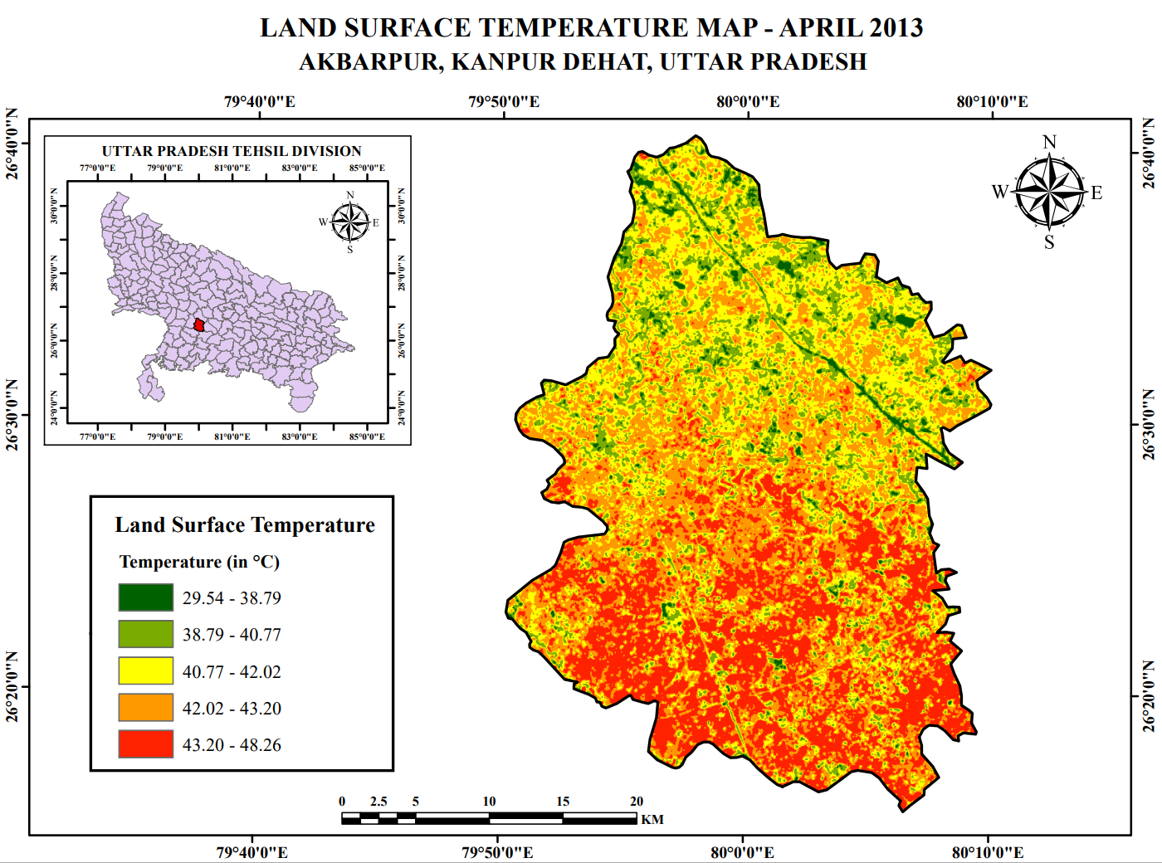
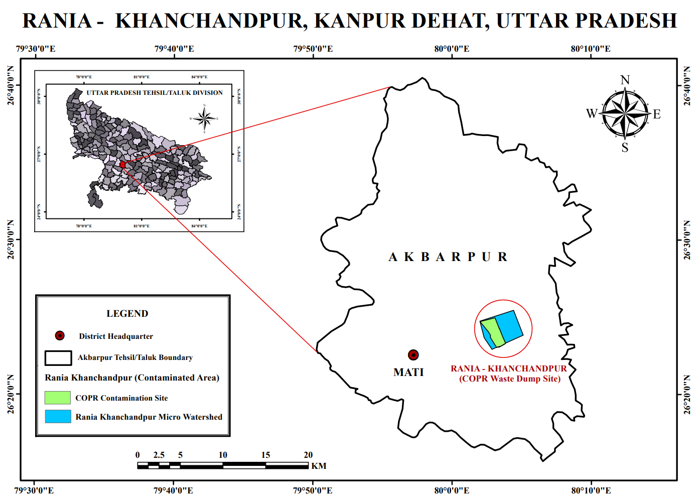
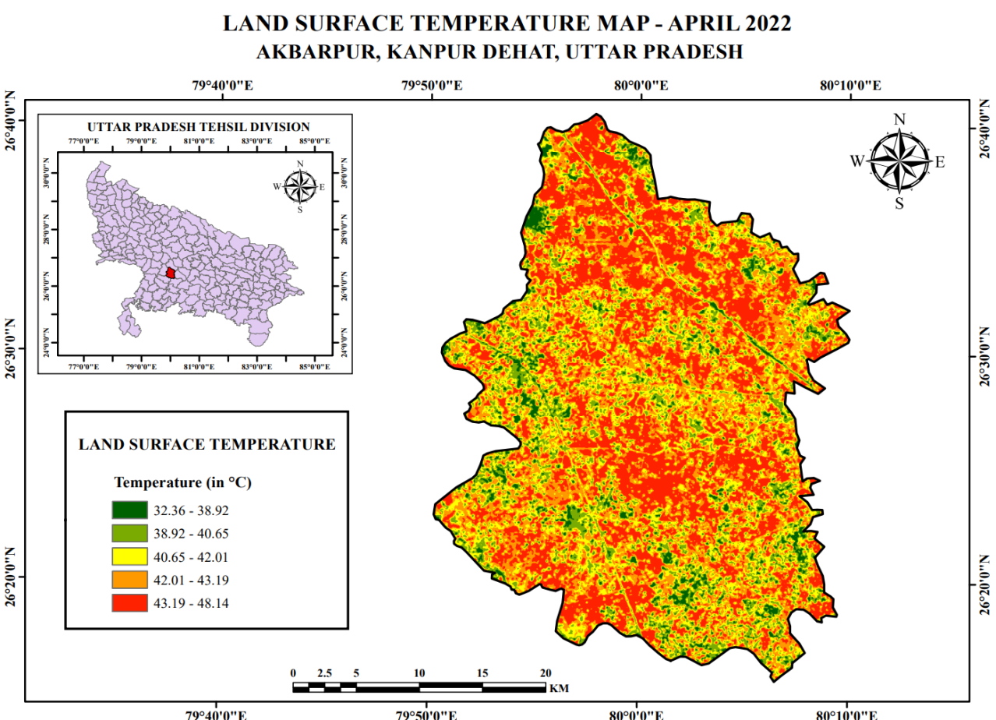




"GLOBAL INDIAN YOUNG SCIENTISTS RESEARCH AND INNOVATION CONFERENCE 2023"
LAND SURFACE TEMPERATURE VARIATION BASED ON REMOTE SENSING OF
RANIA KHANCHANDPUR, KANPUR DEHAT,UTTAR PRADESH
Pankaj Kumar Gupta
Indian Institute of Technology, Delhi 110016
INTRODUCTION
RESULTS
A simplified definition would be how hot the “SURFACE” of the earth would feel to the touch in a particular location. From a satellite point of view, the “surface” is whatever it sees when it looks through the atmosphere to the ground. It could be snow and ice, the grass in a lawn, the roof of a building, or leaves in the canopy of a forest. Thus, Land Surface Temperature (LST) is not the same as their temperature that is included in the daily weather report.
RESEARCH OBJECTIVE
To understand the land surface temperature change over Kanpur Dehat using Landsat 8 OLI & TIRS satellite data.
AREA OF STUDY
Figure 1: Study Area Map
Figure 2: 2013 & 2022 LST Map
METHODOLOGY
S No. | Location |  | Change in Temperature (°C)
 | Latitude | Longitude | 2013 | 2022
Point 1 | 26°35'49.8"N | 80°01'17.4"E | 37.9546 | 43.3977
Point 2 | 26°32'23.5"N | 80°02'31.7"E | 39.2387 | 43.6547
Point 3 | 26°29'22.5"N | 80°00'52.5"E | 38.5326 | 43.5344
Point 4 | 26°22'34.1"N | 79°56'36.1"E | 44.5337 | 36.3869
Point 5 | 26°18'48.0"N | 80°06'33.3"E | 44.3413 | 36.0271
Point 6 | 26°17'17.8"N | 80°02'52.2"E | 44.0207 | 37.1446
PROCESS OF CALCULATING LST
Step 1: Calculate Top of Atmosphere (TOA) Radiance.
TOA (L) = ML + Qcal + AL
Where, ML is band specific multiplicative rescaling factor as mention in imagery metadata; Qcal corresponds to band 10; and AL is band specific additive rescaling factor as mention in metadata (radiance_add_band_10)
Step 2: Calculate TOA Brightness Temperature.
BT=(K2/(In(K1/L)+1))-273.15
K1 & K2 is band-specific thermal conversion constant of landsat-8 band 10 (Mention in metadata); L is TOA (L); and -273.15 is added to convert absolute zero (Kelvin) to degree Celsius.
Step 3: Calculate Normalized Difference Vegetation Index (NDVI).
NDVI = Float(NIR – R )/ Float (NIR + R)
where, R (band 4) is red band (visible region) of landsat-8 satellite; NIR (band 5)is near infrared band of landsat-8 satellite.
Step 4: Calculate Land Surface Emissivity (LSE).
i. Calculation of PV ( Proportion of vegetation )
PV = square[(NDVI-NDVI min) / (NDVI max –NDVI min)]
Where, NDVI min is NDVI lowest value and NDVI max is highest value
ii. Calculation of Land Surface Emissivity
𝜺 = 0.004 * PV + 0.986
Where, PV is proportion of vegetation; 0.004 is surface roughness constant; 0.986 is emissivity value when NDVI value is more than 0.5.
Step 5: Calculate Land Surface Temperature (LST).
LST= (BT/(1+(0.00115*BT/P)*in(e))
Where, BT is brightness temperature; ε is emissivity; P= 1.4388
Table 1: Comparison between LST in 2013 & 2022
CONCLUSION
There is overall rise in the land surface temperature (LST) from 2013 to 2022. There may be a lot of factor influencing the rise in LST approximately from 29°C up to 48°C.
This will impact the microbial degradation of pollutants in and around Rania Khanchandpur. Further increasing land surface temperature will create water stress conditions which will ultimately impact the growth of natural vegetation which may be helpful in hydro remediation.
INNOVATION & POTENTIAL OF THE WORK
This is the first attempt to investigate contaminated site and its hydrometeorological conditions with special focus on Land Surface Temperature (LST) changes.
Linking surface temperature change to the geochemistry, soil moisture and hydrological processes of contaminated sites under varying climatic conditions.
AKNOWLEDGEMENT
The fund received from the SERB as prestigious Ramanujan Fellowship to Dr. Pankaj Gupta (RJF/2021/100159) is well Acknowledged.

